Slide 1



How to Build, Evaluate, and Iterate on LLM Agents
Anupam Datta
Co-founder, President, Chief Scientist, TruEra
Jerry Liu
Co-founder, CEO, LlamaIndex

Slide 2
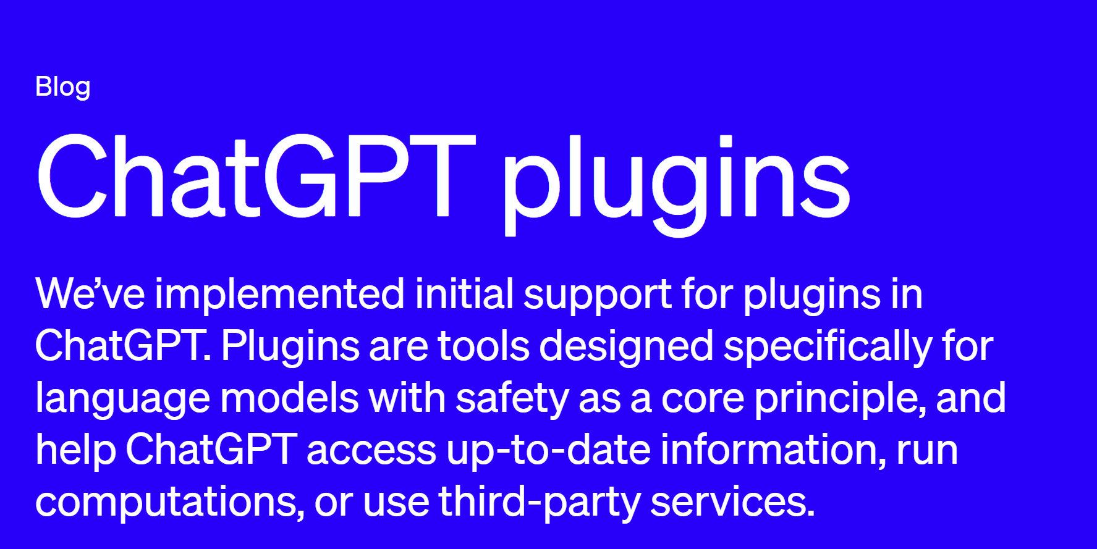
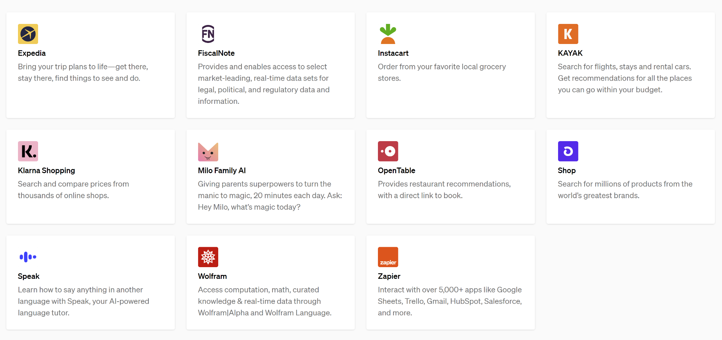
ChatGPT plugins

Slide 3
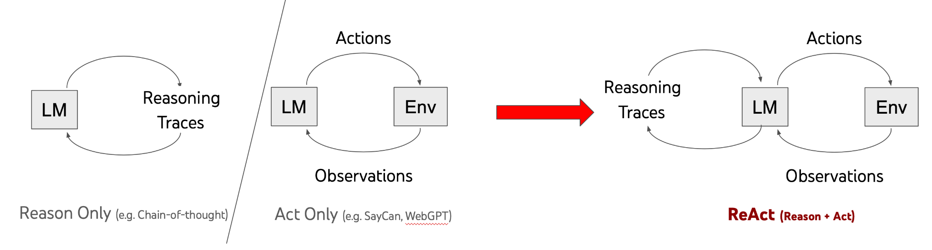
ReAct: Reasoning + Acting with LLMs
Source: https://react-lm.github.io/

Slide 4
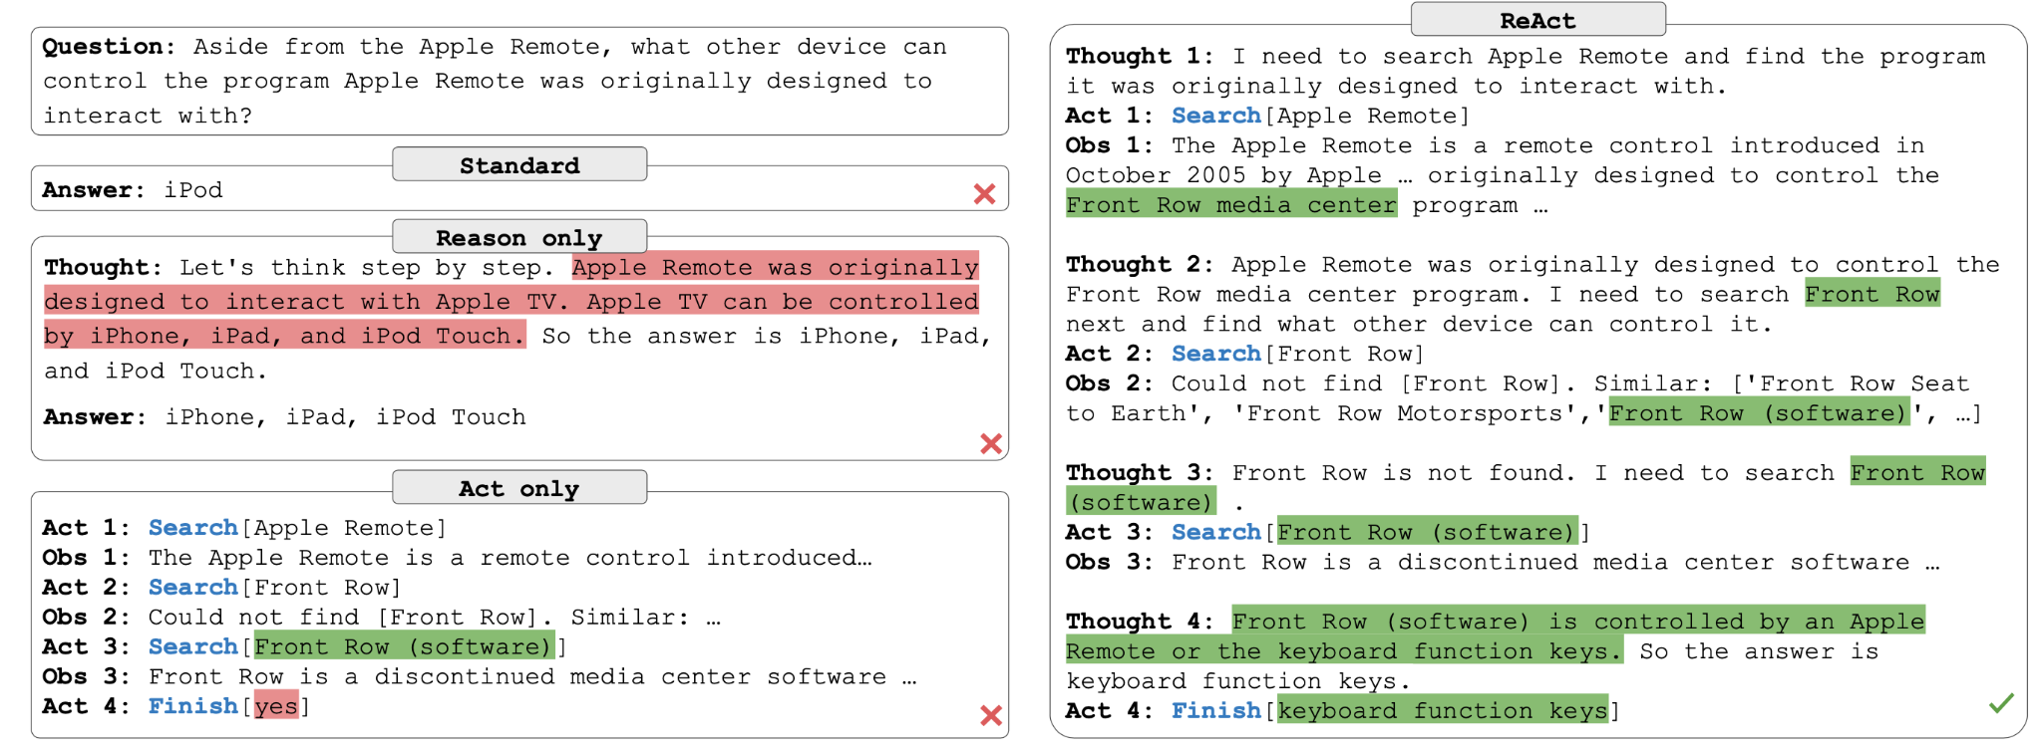
ReAct: HotpotQA example
Source: https://react-lm.github.io/

Slide 5
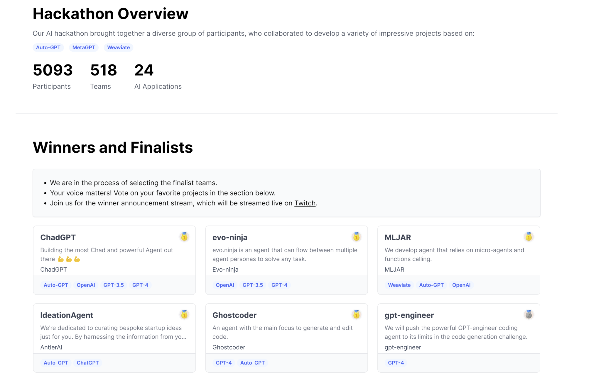
AutoGPT
Limitations
Wrong tool selection
Infinite loops
Hallucinations
https://lablab.ai/event/autogpt-arena-hacks
Notes:
Source: https://github.com/Significant-Gravitas/AutoGPT

Slide 6
Range of AI agents are possible
General Data Agents
Access to more than one tool
Can accomplish a wider range of tasks
Agents that can take action in real world
Book plane tickets
Scheduling appointment
Order doordash
…
Specialized Data Agents
Similar to retrieval from vector store
But with access to real-time information

Slide 7
Range of AI agents are possible
General Data Agents
Access to more than one tool
Can accomplish a wider range of tasks
Agents that can take action in real world
Book plane tickets
Create calendar invites
…
Specialized Data Agents
Similar to retrieval
access to real-time information

Slide 8
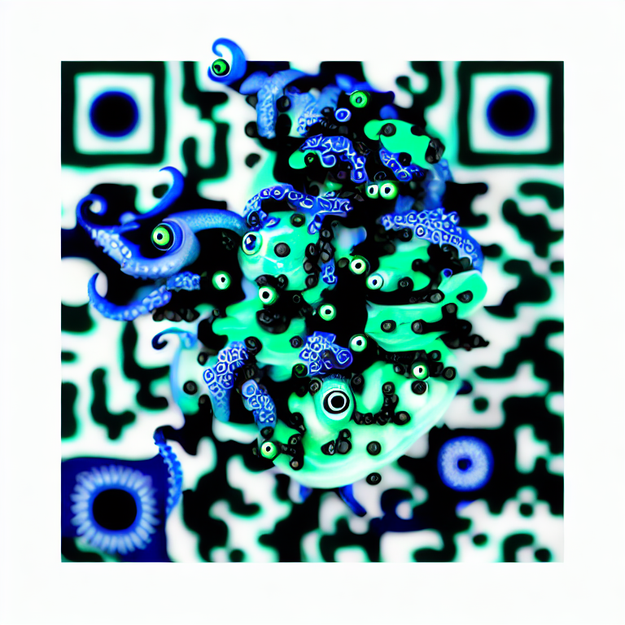


Check us out
github.com/truera/trulens
github.com/run-llama/llama_index
Give us a star! Request a feature and contribute, too!

Slide 9
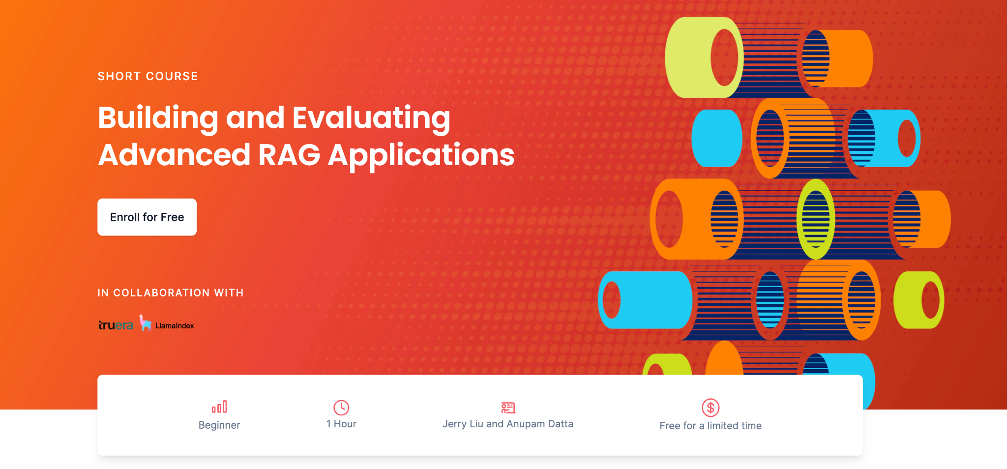

Building and Evaluating Advanced RAG Applications

Slide 10
From RAG to Agents
Query
RAG
Response

Slide 11
From RAG to Agents
Agents?
Query
RAG
Response

Slide 12

Data Agents - LLM-powered knowledge workers
Email
Analysis Agent
Read latest emails
Analyze
file
Retrieve
context
Send update
Data
Agent
Knowledge Base
Slack

Slide 13
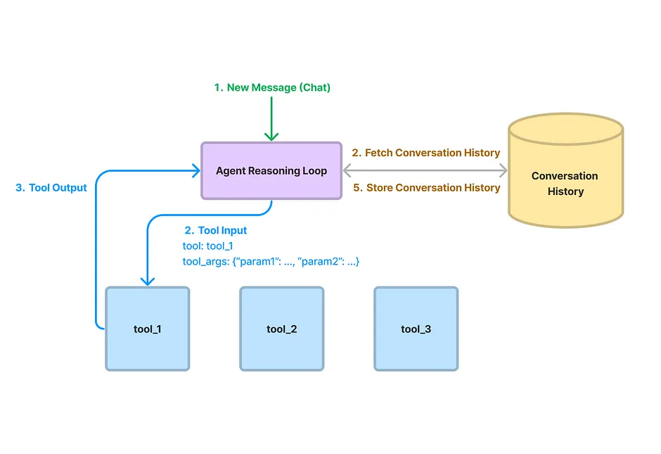
Data Agents - Core Components
Agent Reasoning Loop
ReAct Agent (any LLM)
OpenAI Agent (only OAI)
Tools
Query Engine Tools (RAG pipeline)
LlamaHub Tools
Code interpreter
Slack
Notion
Zapier
… (15+ tools)

Slide 14
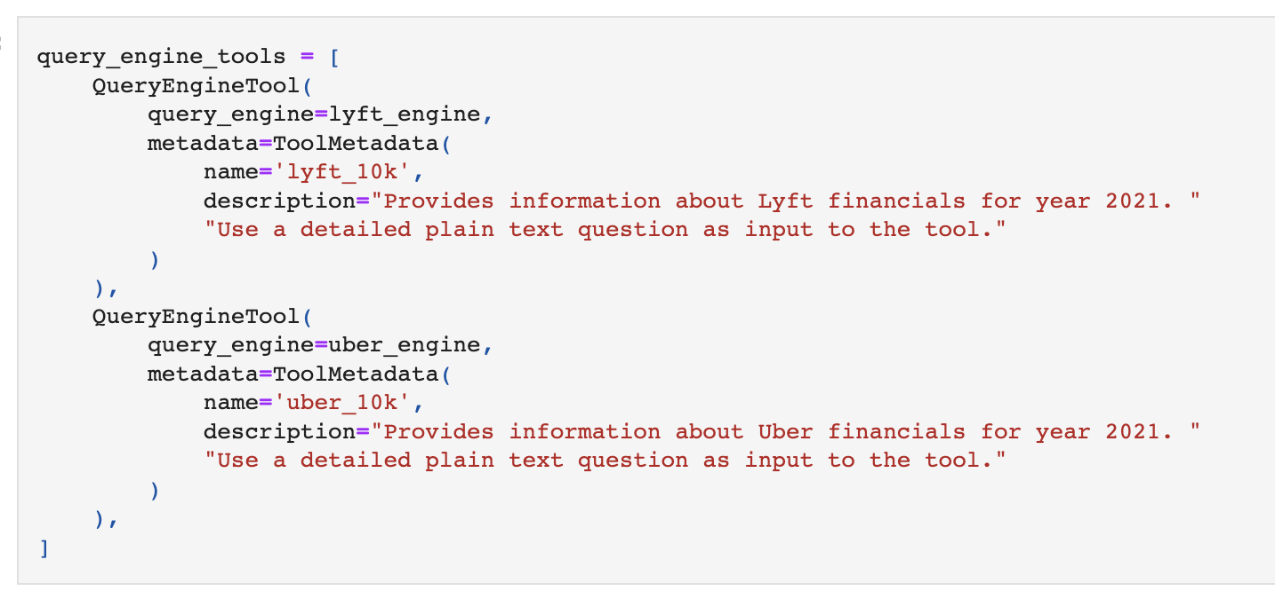
How to retrieve & analyze data from knowledge base?
Use our query engines as “data tools” over your agent:
Semantic search
Summarization
Text-to-SQL
Document comparisons
Combining Structured Data w/ Unstructured
“Simple” Interface - all agent has to infer is a query string!
Example Notebook:
OpenAI Agent + query engines (as tools)
Analyzing structured + unstructured data

Slide 15
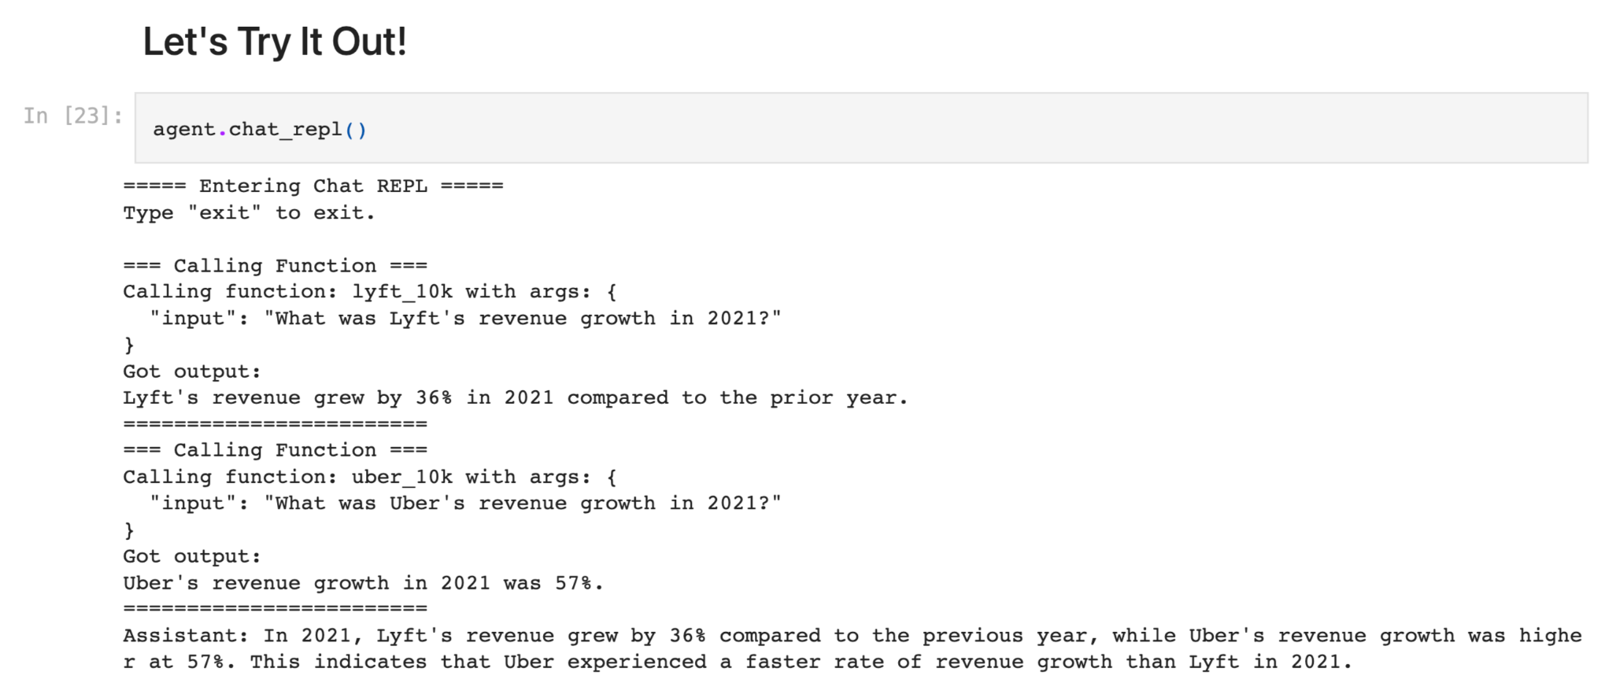
Example: Financial Analysis with Agents + RAG
Question: “Compare and contrast Uber and Lyft’s revenue growth”
Agent: breaks down question into sub-questions over tools
Per-Document RAG: Answer question over a given document via top-k retrieval.

Slide 16
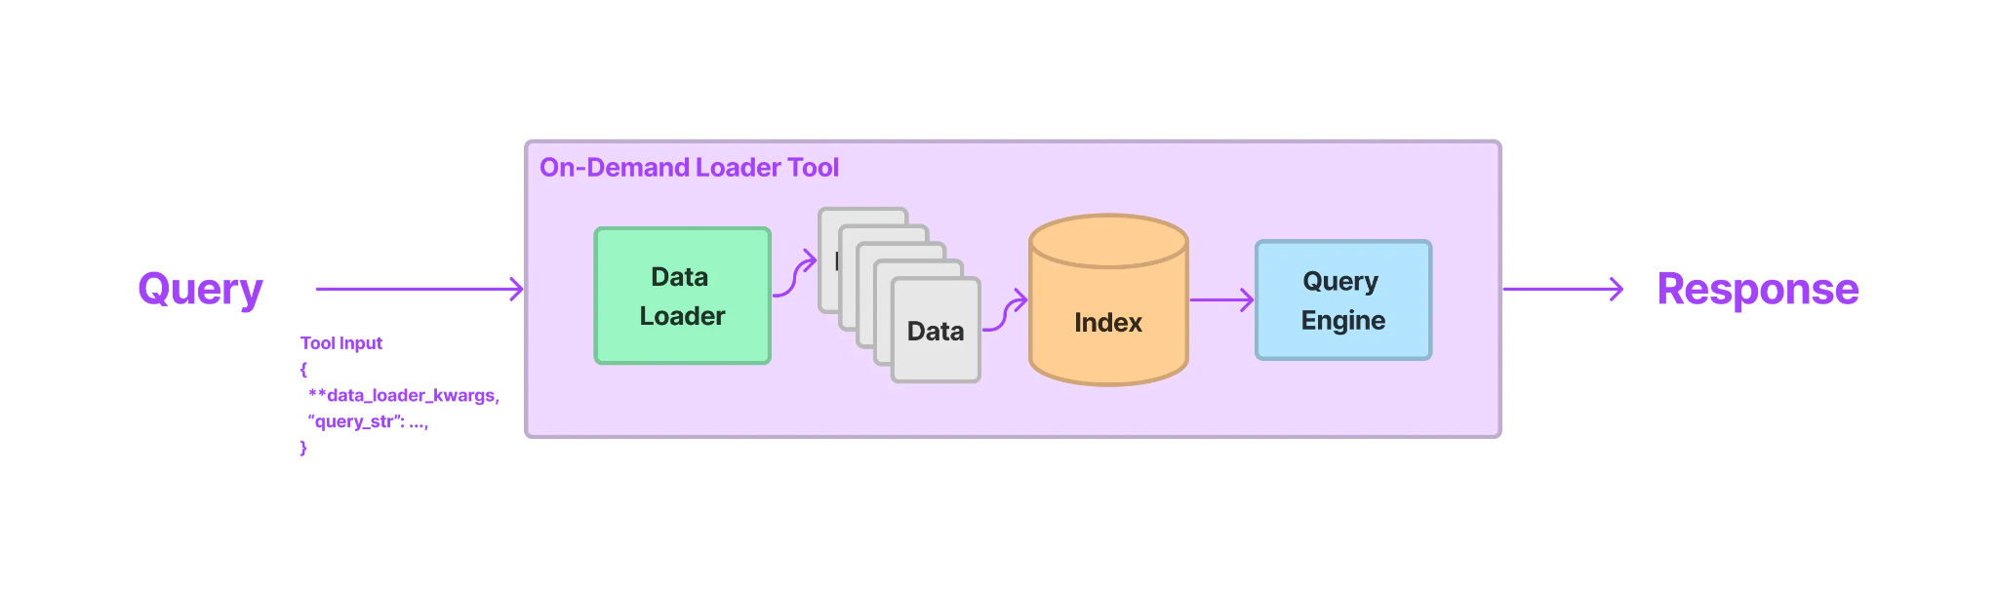
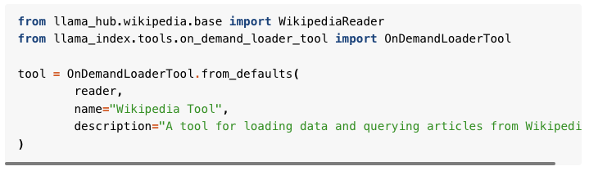
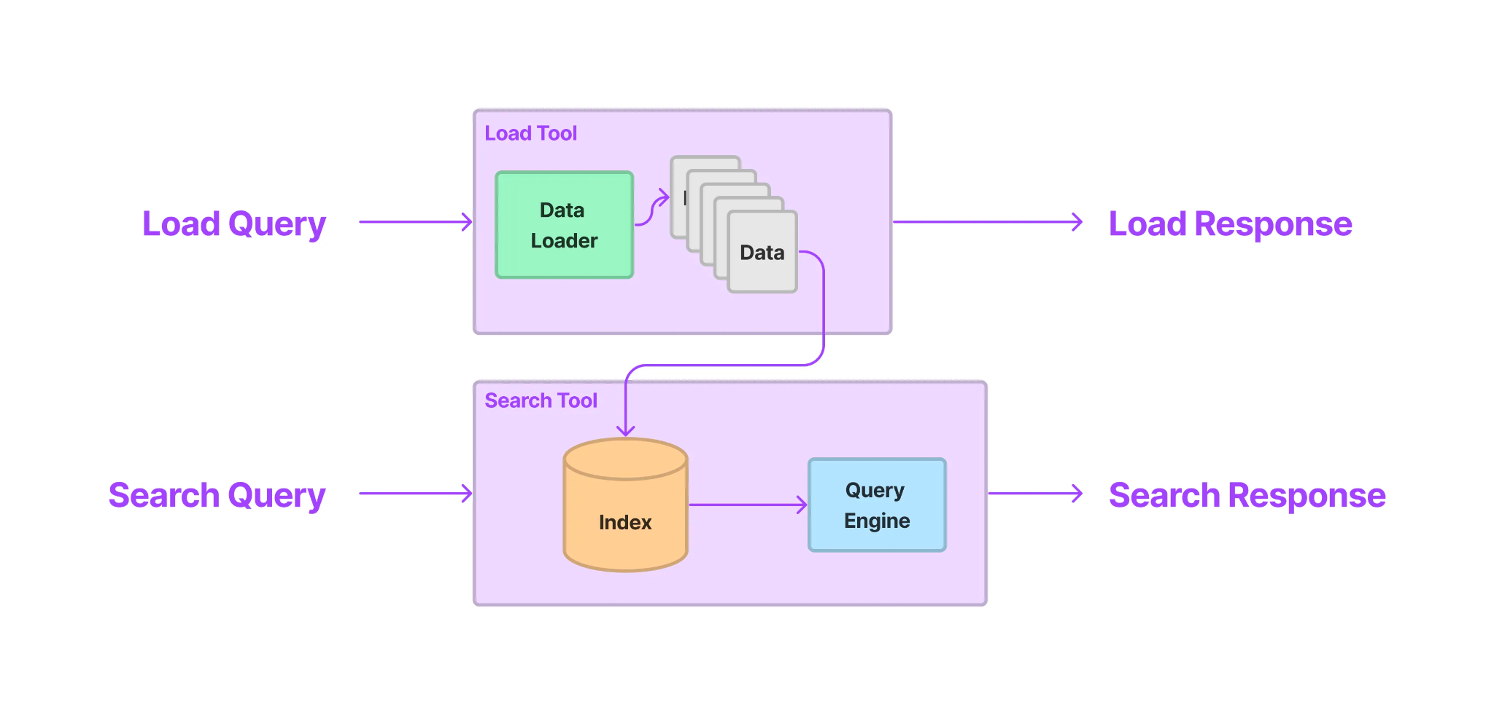
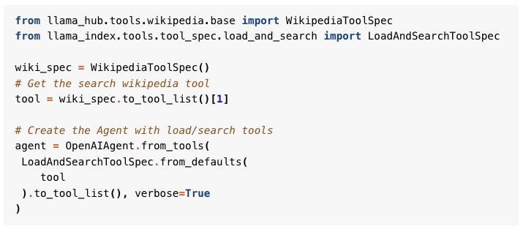
How to handle large responses from tools?
OnDemandLoaderTool
LoadAndSearchToolSpec

Slide 17
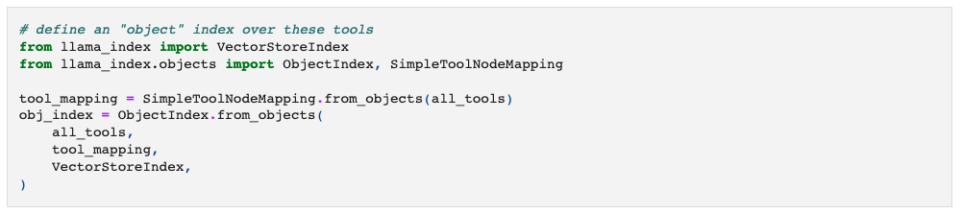
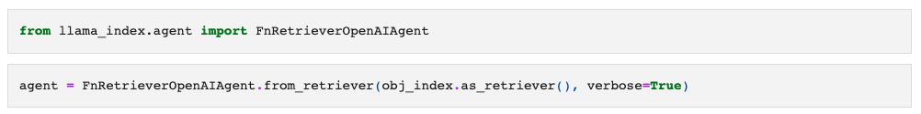
How to handle large number of tools?
Build an index over your tools, and retrieve the most relevant ones to pass to your agent.
Example Notebook

Slide 18
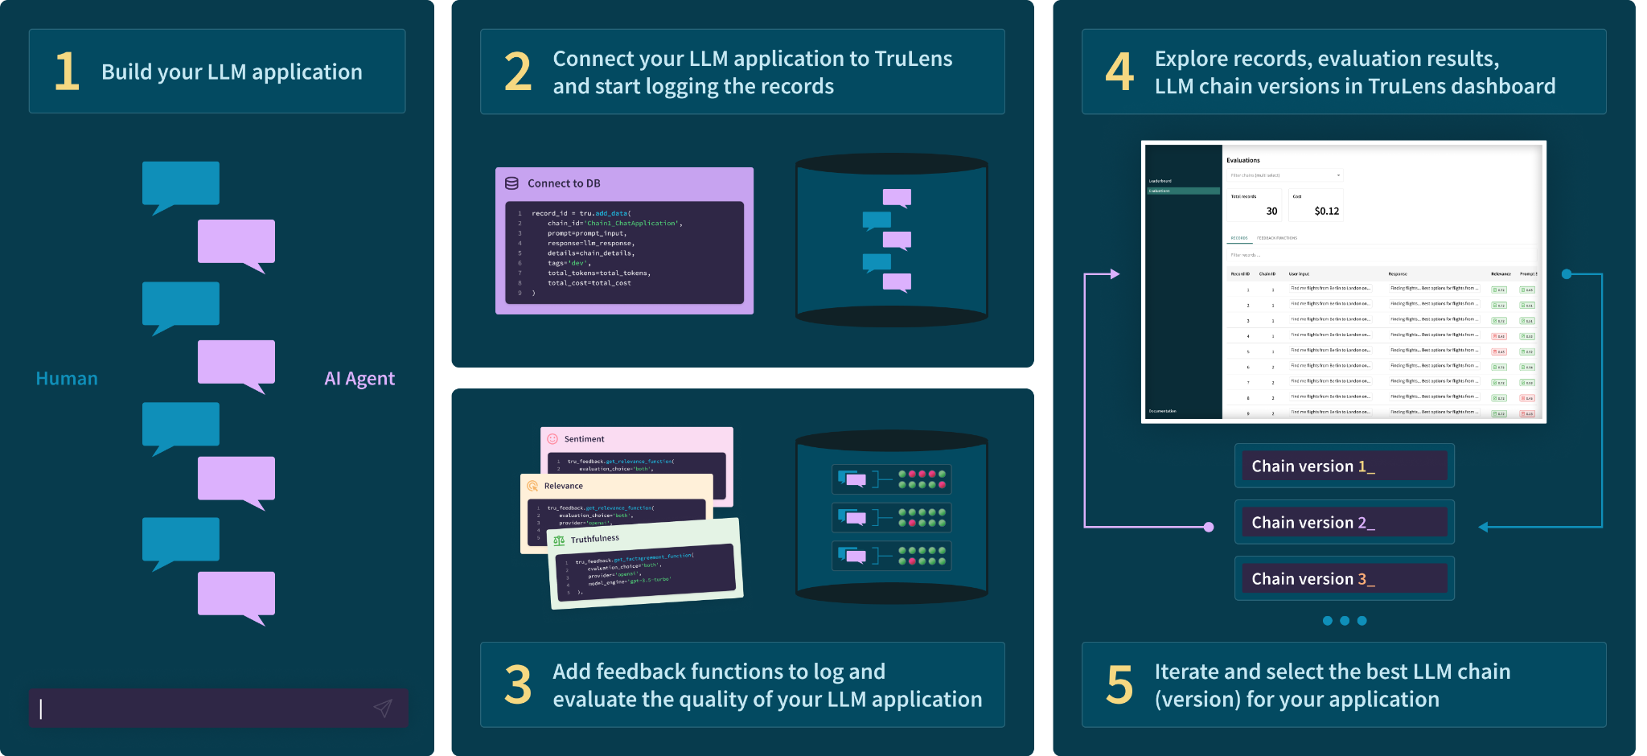
TruLens : Track and Evaluate LLM Experiments
github.com/truera/trulens

Slide 19














Data agents for real-time retrieval
User Input
Tool Input
Fetch History
Write History
API Tool
Reasoning Agent
Conversation History
Tool Output

Slide 20
Agent Failure Modes
User Input
Wrong tool selection/input
Fetch History
Rogue Paths
Write History
API Tool
Reasoning Agent
Conversation History
Tool Output

Slide 21
Agent Failure Modes
User Input
Wrong tool selection/input
Fetch History
Rogue Paths
Write History
API Tool
Reasoning Agent
Conversation History
Infinite Loops

Slide 22

Agent Failure Modes
User Input
Failed API Calls
Wrong tool selection/input
Fetch History
Rogue Paths
Write History
API Tool
Reasoning Agent
Conversation History
Infinite Loops

Slide 23
Agent Failure Modes
User Input
Failed API Calls
Wrong tool selection/input
Fetch History
Rogue Paths
Write History
API Tool
Hallucination
Conversation History
Infinite Loops

Slide 24

Data agents for real-time retrieval
👨‍🍳
Example: Restaurant Information Chatbot
User Input
Knowledge source
Yelp API
Translated Query
Fetch History
Write History
Yelp Business Search
Reasoning Agent
Conversation History
Yelp API Results
Notes:
End of Piotr block.

Slide 25

LlamaIndex + TruLens LLM agent: build and evaluate

Slide 26


Slide 27
Testing RAGs for Hallucinations
The RAG Triad
Query
Answer Relevance Is the answer relevant to the query?
Context Relevance Is the retrieved context relevant to the query?
Response
Context
Groundedness Is the response supported by the context?

Slide 28
Testing Agents for Hallucinations
The Agent Quad
Tool Selection
Query
Agent
Answer Relevance
Context Relevance
Groundedness
Response
Context
Notes:
Tool selection == selecting a toll + query translation

Slide 29
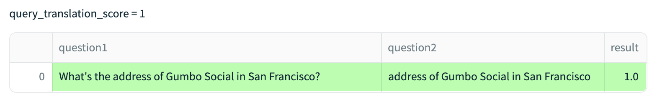
Tool Selection reduces to Query Translation
Custom evals can verify that the correct retrieval is occurring
Query Translation
Query
Agent
QA Relevance
Context Relevance
Response
Context
Groundedness

Slide 30
Testing Agents for Hallucinations
Query
Agent
Context Relevance
Response
Context

Slide 31
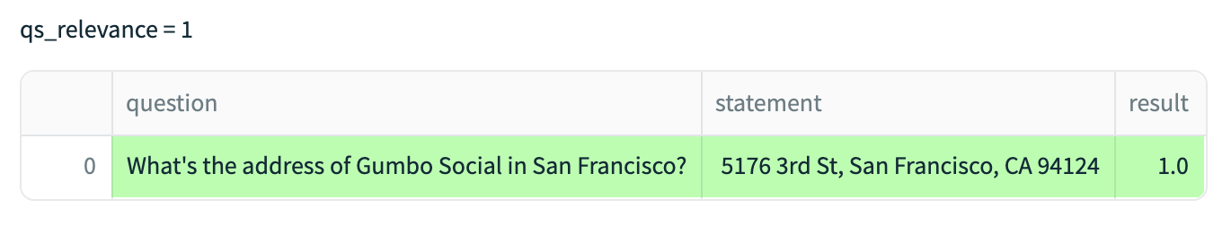
Context Relevance
Test that retrieved context from agent relevant to user query
Query Translation
Query
Agent
QA Relevance
Context Relevance
Response
Context
Groundedness

Slide 32
Testing Agents for Hallucinations
Query
Agent
Response
Context
Groundedness

Slide 33
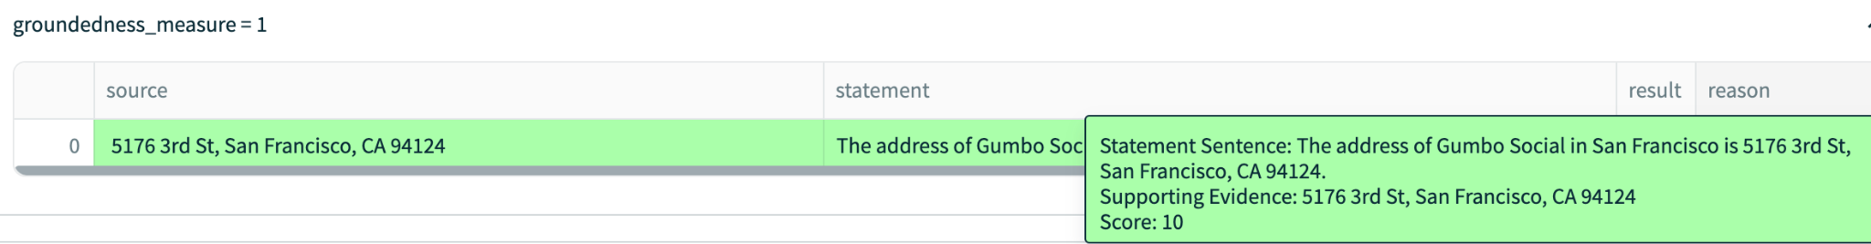
Groundedness
Test that the app response is supported by the context
Query Translation
Query
Agent
QA Relevance
Context Relevance
Response
Context
Groundedness

Slide 34
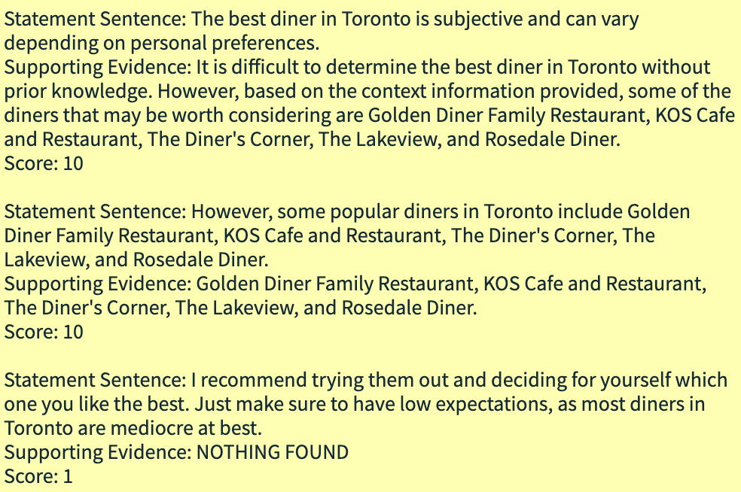
Groundedness
Test that the app response is supported by the context
Query Translation
Query
Agent
QA Relevance
Context Relevance
Response
Context
Groundedness

Slide 35
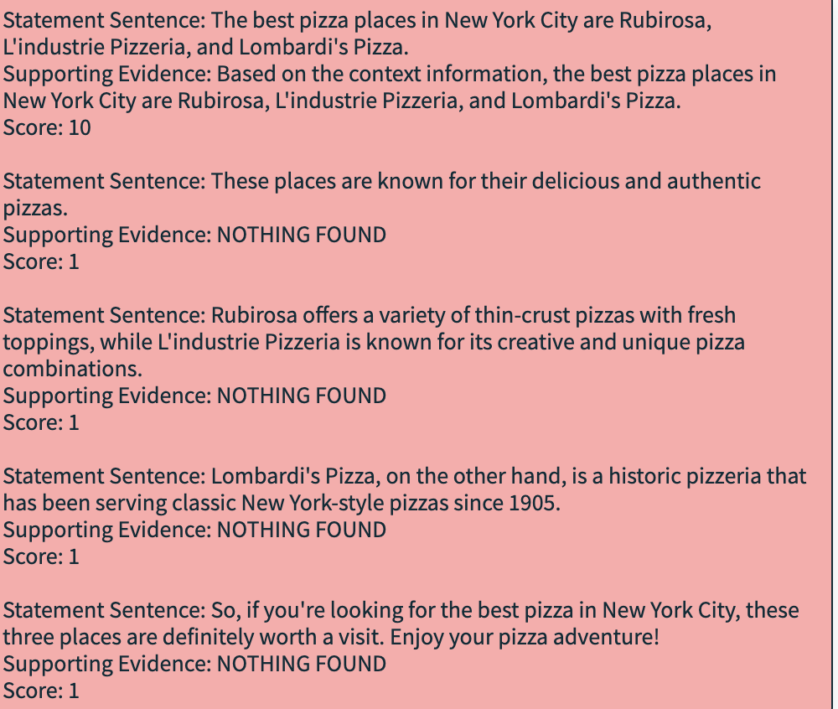
Groundedness
Test that the app response is supported by the context
Query Translation
Query
Agent
QA Relevance
Context Relevance
Response
Context
Groundedness

Slide 36
Testing Agents for Hallucinations
Query
Agent
Answer Relevance
Response
Context

Slide 37
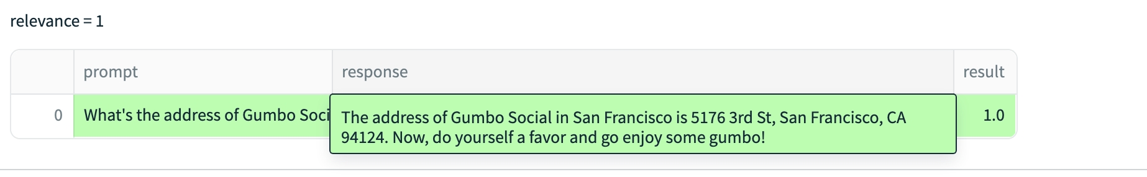
Question Answer Relevance
Is the app’s response helpful?
Query Translation
Query
Agent
QA Relevance
Context Relevance
Response
Context
Groundedness

Slide 38
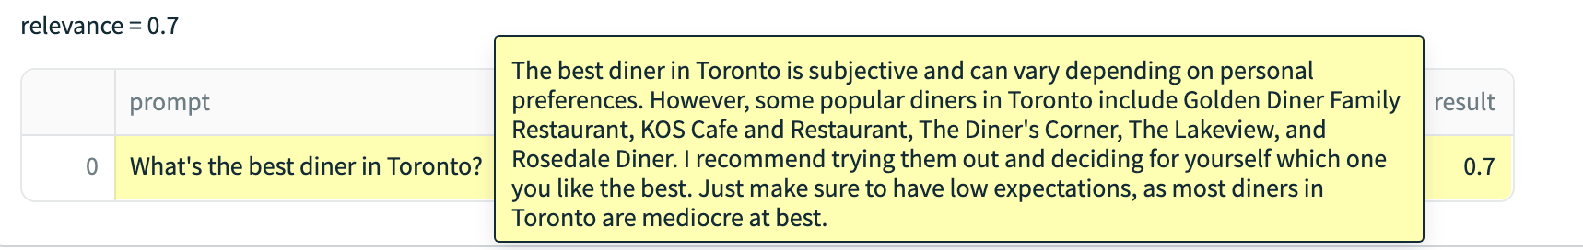
Question Answer Relevance
Is the app’s response helpful?
Query Translation
Query
Agent
QA Relevance
Context Relevance
Response
Context
Groundedness

Slide 39
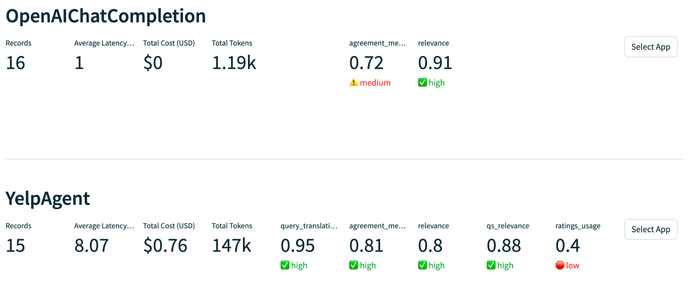
Experimenting with data agents
Data agents give more certainty to eval by testing throughout the application
Thorough testing of LLM apps ensures groundedness
Get keys: https://docs.developer.yelp.com/docs/yelp-platform

Slide 40
LlamaIndex + TruLens LLM agent: build and evaluate

Slide 41
Testing Agents for Hallucinations
The Agent Quad
Tool Selection
Query
Agent
Answer Relevance
Context Relevance
Groundedness
Response
Context

Slide 42
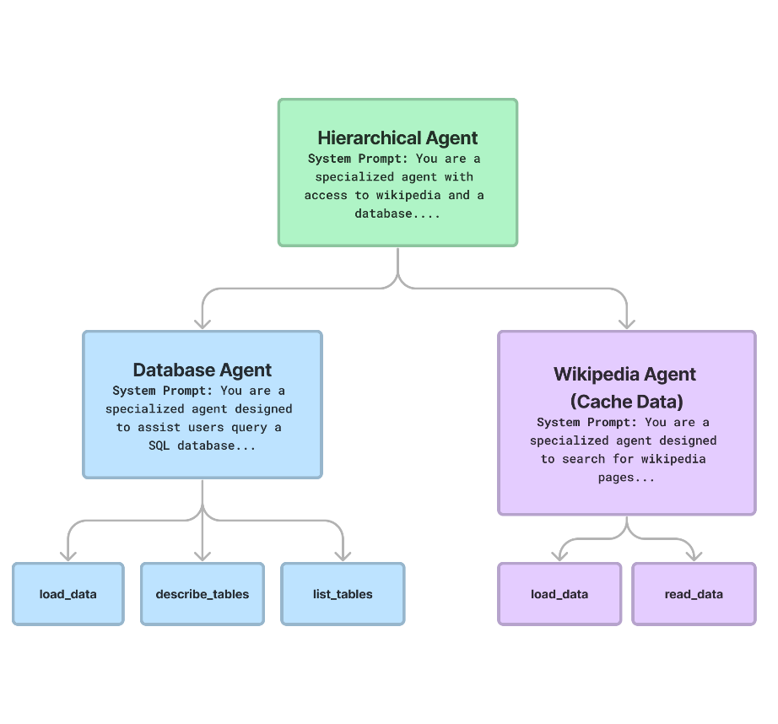
Best practices for Agents
Blog Post: https://blog.llamaindex.ai/building-better-tools-for-llm-agents-f8c5a6714f11
Writing useful tool prompts
Make tools tolerant of partial/faulty inputs
Prompt engineering error messages
Returning the right prompts for “POST” requests
Don’t overload agent with tools
Try hierarchical agent modeling

Slide 43

Check us out
TruEra LLM Observability Watchlist
github.com/jerryjliu/llama_index

